Slide 1
Independent Project milestone 2
By: Katrina Zathey

Slide 2
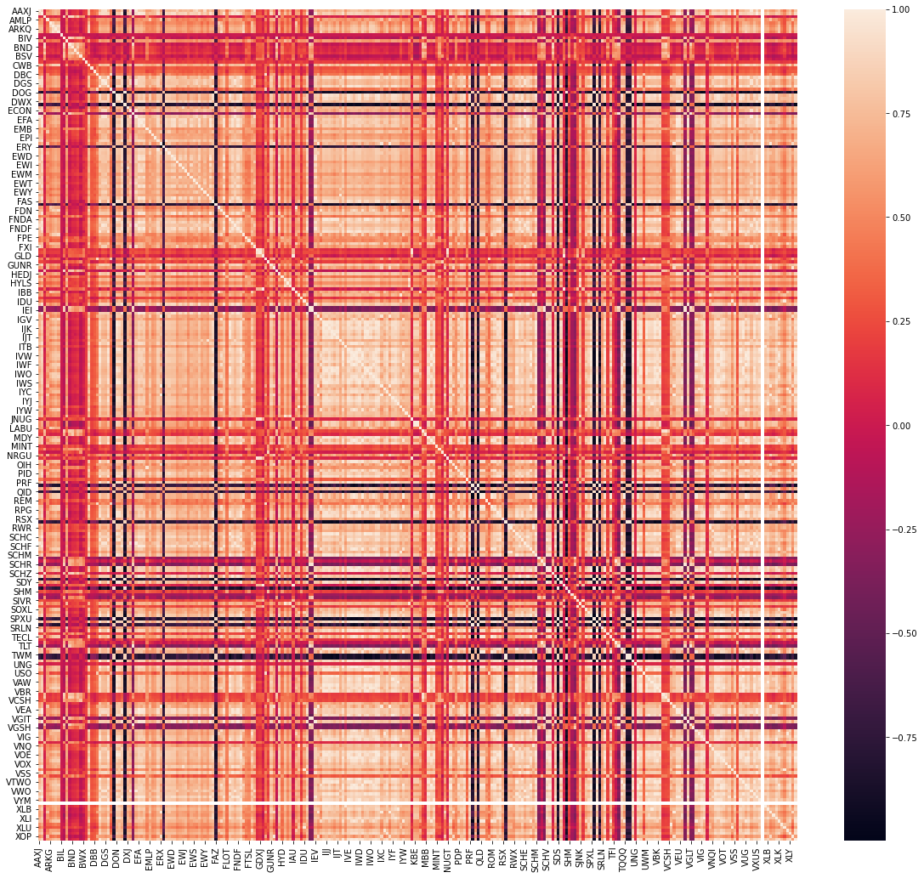
Correlation Heatmap

Slide 3
Covariance estimation
Switched from sample covariance to Ledoit and Wolf shrinkage method
Covariance matrix is unstable where number of assets is greater than the number of historical observations
Need to ensure estimated covariance matrix is non-singular and positive definite
Source: 691.pdf (upf.edu)

Slide 4
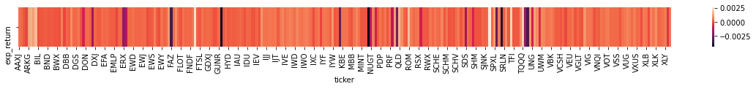
Returns heatmap

Slide 5
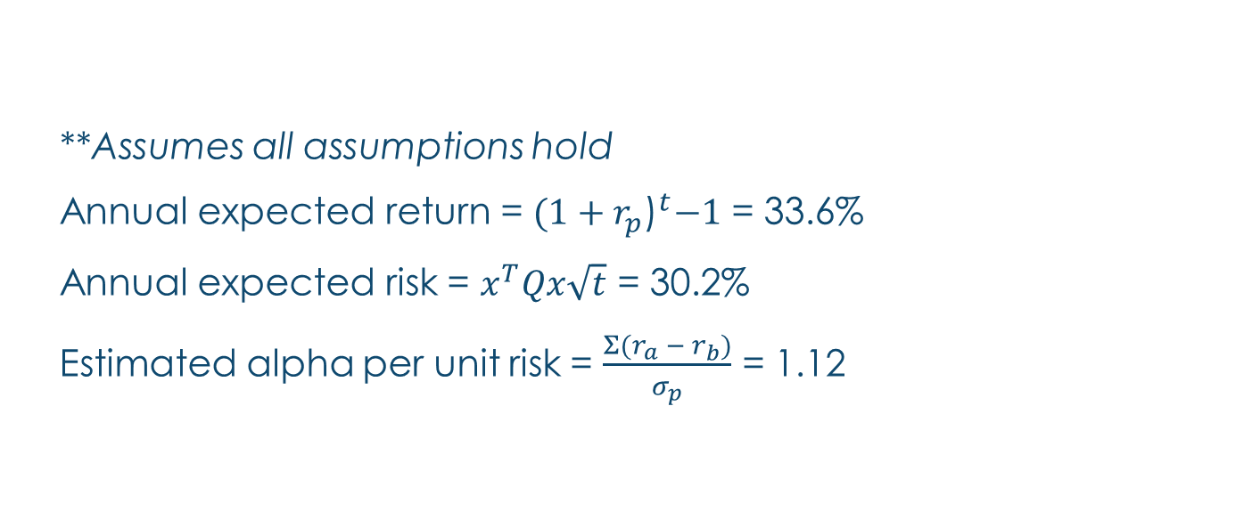
Summary Stats
**Assumes all assumptions hold
Annual expected return = ${(1+r_{p}\text{)}}^{t}−1$ = 33.6%
Annual expected risk = $x^{T}Qx\sqrt{t}$ = 30.2%
Estimated alpha per unit risk = $\frac{Σ(r_{a} − r_{b})}{σ_{p}}$ = 1.12

Slide 6
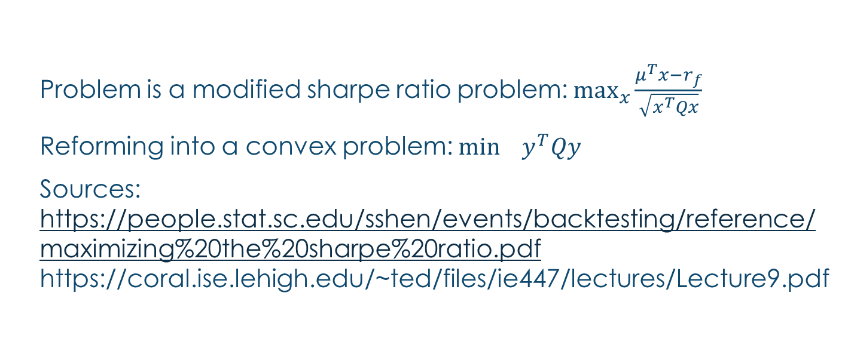
Reforming optimization into convex problem
Problem is a modified sharpe ratio problem: $\max_{x}{\frac{μ^{T}x−r_{f}}{\sqrt{x^{T}Qx}}}$
Reforming into a convex problem: $\min_{}{y^{T}Qy}$
Sources: https://people.stat.sc.edu/sshen/events/backtesting/reference/maximizing%20the%20sharpe%20ratio.pdf https://coral.ise.lehigh.edu/~ted/files/ie447/lectures/Lecture9.pdf

